Slide 1










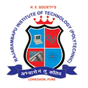


s
Hosted By
Supported By
IDEATHON2024 Co-Hosted by
NETRARIT Foundation (NRiT)
Technology Business Incubator
BUSINESS IDEA PRESENTATION
IDEATHON2024
TITLE :
CONTROLLING ROBOT BY USING GOOGLE
ASSISTANT, BLUETOOTH AND VOICE COMMAND WITH VACCUM CLEANER

Slide 2


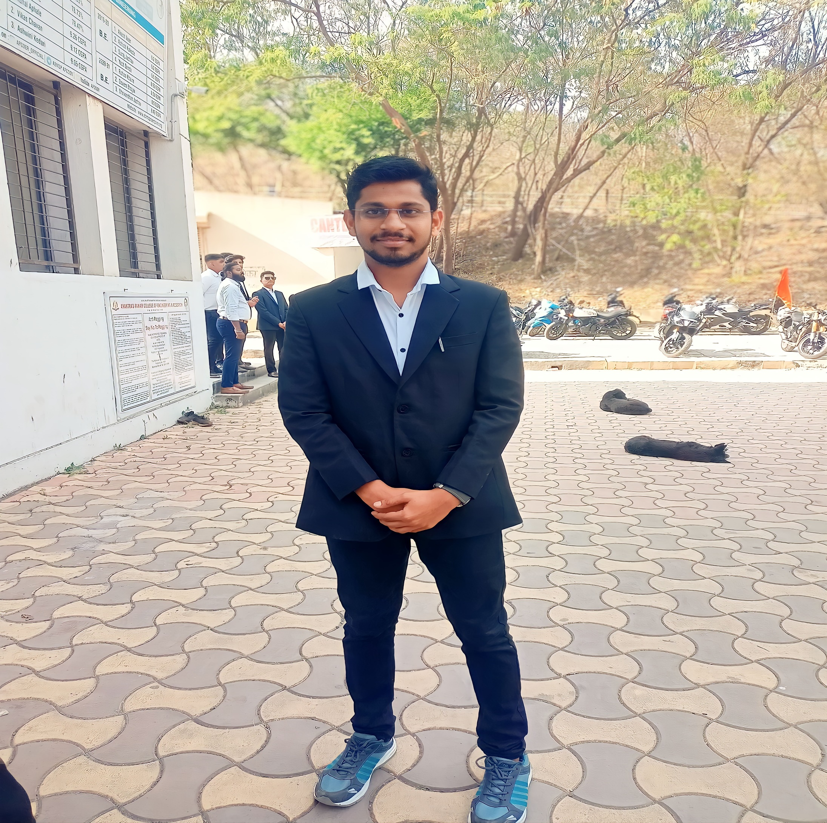
Hosted By
Supported By
IDEATHON2024 Co-Hosted by
NETRARIT Foundation (NRiT)
Technology Business Incubator
Mr. Pavan Kawade ,
Project Manager/Coordinator,
Responsible for overall project management, planning, resource allocation, and coordination among team members.
ABOUT
TEAM
Mr. Swapnil Magar ,
Hardware Specialist, Software Developer,
Develops the software application for controlling and monitoring the smart system. This includes programming the microcontrollers, developing the user interface, and implementing communication protocols.

Slide 3


Hosted By
Supported By
IDEATHON2024 Co-Hosted by
NETRARIT Foundation (NRiT)
Technology Business Incubator
Mr. Shivaji Sawant ,
Hardware Specialist, Software Developer,
Develops the software application for controlling and monitoring the smart system. This includes programming the microcontrollers, developing the user interface, and implementing communication protocols.
ABOUT
TEAM
Mr. Nikhil Patil ,
User Experience (UX) Designer,
Designs the user interface (UI) and user experience (UX) of the smart application to ensure it is intuitive, user-friendly, and aesthetically pleasing. They conduct user research, create wireframes and prototypes, and collaborate closely with the software developer to implement UI/UX designs.

Slide 4

Hosted By
Supported By
IDEATHON2024 Co-Hosted by
NETRARIT Foundation (NRiT)
Technology Business Incubator
ABOUT
PROBLEM STATEMENT
Current vacuum cleaning methods involve manual control, limiting efficiency and convenience. Users need to physically operate the vacuum cleaner, monitor its progress, and often move obstacles out of its path. These limitations can be addressed by developing an IoT-based smart vacuum cleaner

Slide 5

5
Hosted By
Supported By
IDEATHON2024 Co-Hosted by
NETRARIT Foundation (NRiT)
Technology Business Incubator
EXISTING OR CURRENT SOLUTION
Existing or current solutions in the market for robot vacuum cleaners controlled by Google Assistant include:
iRobot Roomba i7+ with Clean Base: This model offers voice control through Google Assistant and Amazon Alexa. It also features Wi-Fi connectivity
Ecovacs Deebot N79S: While it may not have direct integration with Google Assistant, the Deebot N79S offers voice control through Amazon Alexa and app control via Wi-Fi connectivity.

Slide 6
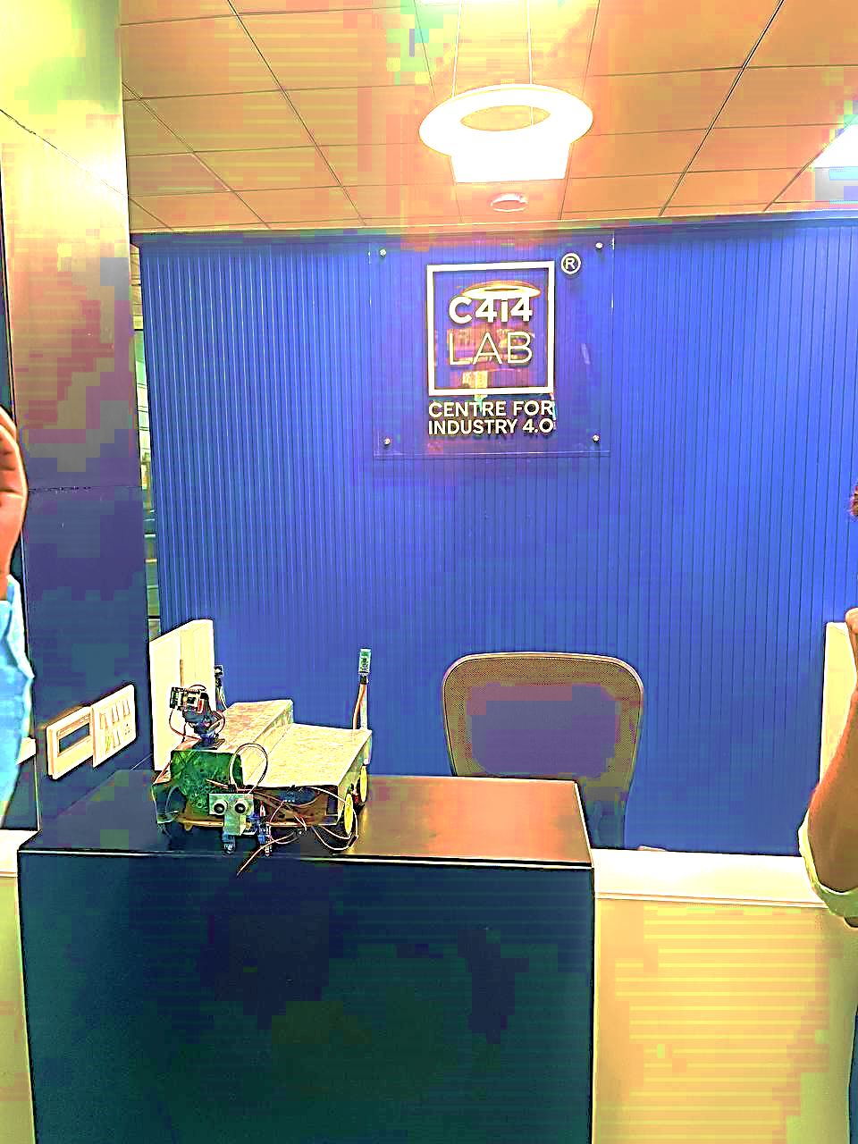

Hosted By
Supported By
IDEATHON2024 Co-Hosted by
NETRARIT Foundation (NRiT)
Technology Business Incubator
ABOUT
YOUR SOLUTION
Infrared sensor for efficient road cleaning.
Automatic obstacle detection for seamless navigation.
Bluetooth connectivity for remote access and control.
Low-power camera integration.
Automatic charging system for uninterrupted operation.
Remote control capability for convenient usage.
High-power vacuum cleaner for effective cleaning performance.
Multi-surface cleaning capability for versatility.
Eco-friendly operation with energy-saving features.
User-friendly mobile app interface for intuitive control and customization.
Integration with Google Assistant for voice control.

Slide 7
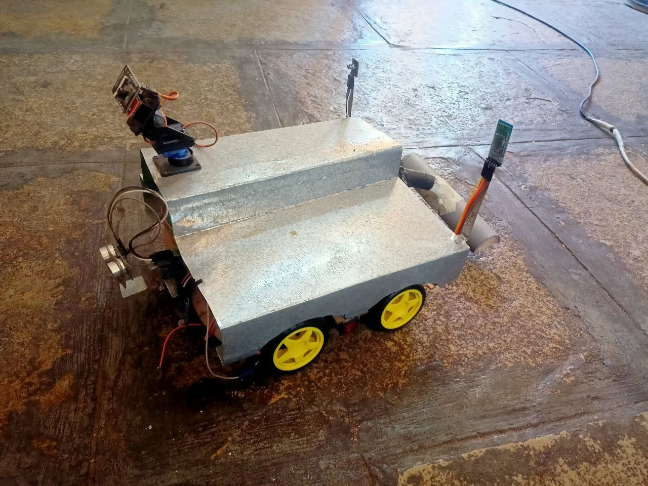
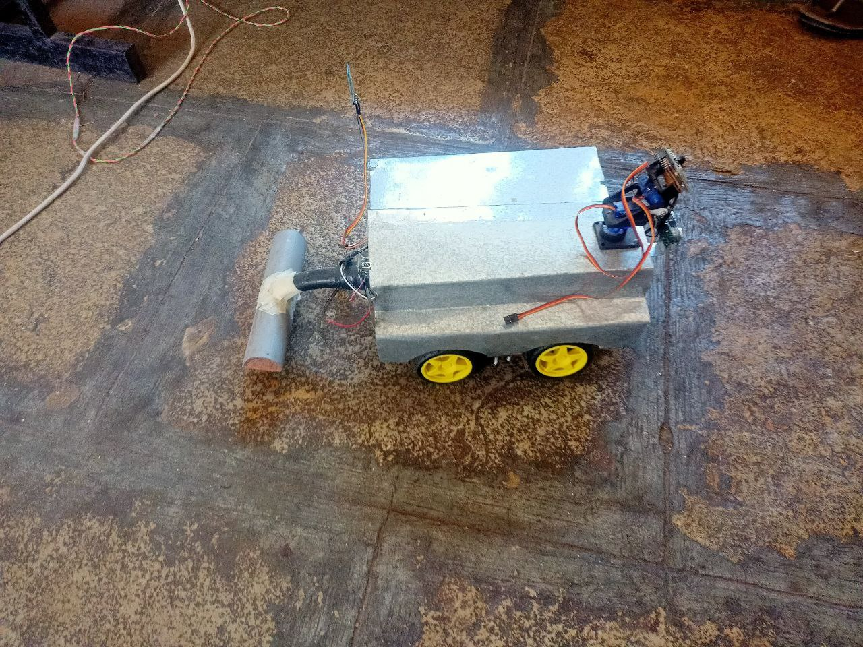
Hosted By
Supported By
IDEATHON2024 Co-Hosted by
NETRARIT Foundation (NRiT)
Technology Business Incubator
PRODUCT’S / SERVICE’S
UNIQUE VALUE PROPOSITION

Slide 8
Hosted By
Supported By
IDEATHON2024 Co-Hosted by
NETRARIT Foundation (NRiT)
Technology Business Incubator
BUSINESS PLAN AND REVENUE MODEL
Revenue Model:
Product Sales: Offer different models with varying features and price points:
Entry-level model: 7000 Rs
Mid-range model with advanced features: 9000 Rs
High-end model with premium features and accessories: 10,000 Rs
Subscription Model: Offer premium subscription packages for additional features such as enhanced cleaning modes, extended warranty, and priority customer support:
Monthly subscription: 900 Rs
Annual subscription: 8,800 Rs (discounted rate)
Accessories and Add-ons: Sell accessories and replacement parts such as filters, brushes, and batteries for additional revenue.
Partnerships and Licensing: Explore partnerships with smart home device manufacturers for integration opportunities and licensing agreements.

Slide 9
Hosted By
Supported By
IDEATHON2024 Co-Hosted by
NETRARIT Foundation (NRiT)
Technology Business Incubator
COMPETITORS AND MARKET ANALYSIS
COMPETITORS
iRobot Corporation (Roomba)
Ecovacs Robotics
Market Analysis:
Analysis of the smart home automation market, including the demand for IoT-based products and voice-controlled devices.
Identification of target customers, their preferences, and pain points related to traditional vacuum cleaning methods.
Assessment of competitors offering similar products and their market share.

Slide 10
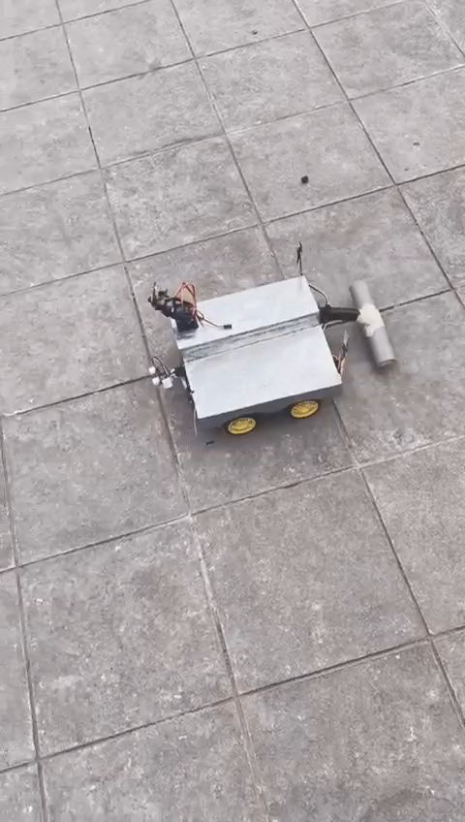
IDEATHON2024
Hosted By
Supported By
IDEATHON2024 Co-Hosted by
NETRARIT Foundation (NRiT)
Technology Business Incubator
PROJECT
DEMO

Slide 11
Hosted By
Supported By
IDEATHON2024 Co-Hosted by
NETRARIT Foundation (NRiT)
Technology Business Incubator
THANK YOU

